Slide 1

House price prediction
REINFORCEMENT-5
BY-
JOTHEESWARAN S
DA&DS-FEB’25
09-06-2025

Slide 2
AGENDA
DATA INTRODUCTION
1
DATA PREPARATION
2
ANALYSIS&VISUALIZATION
3
CONCLUSION&RECOMMENDATION
4

Slide 3
DATA INTRODUCTION
This housing dataset provides an extensive and structured collection of information related to residential real estate properties.
It is specifically designed to support a wide range of analyses in the real estate domain, enabling stakeholders to make data-driven decisions.
The dataset includes attributes that describe both the physical characteristics and locational context of properties, which are crucial in understanding property valuation, market dynamics, and buyer preferences.

Slide 4
DATA COLUMNS
Date
Price
Bedrooms
Bathrooms
Sqft_living
Sqft_lot
Floors
Waterfront
View
Condition
Sqft_above
Sqft_basement
Yr_built
Yr_renovated
Street
City
Statezip
Country.

Slide 5
DATA PREPARATION
Date:
Converted to a datetime format for consistency.
Extracted time-based features like year and month for trend analysis.
Price:
Replaced zero values with the median price to maintain realistic estimates.
Removed outliers using techniques like IQR or Z-score filtering.
Bedrooms:
Standardized inconsistent values (e.g., removing extreme anomalies like 0 bedrooms).
Eliminated duplicates and ensured correct data types.
Bathrooms:
Verified logical consistency, ensuring fractional values were correctly interpreted.
Checked for missing or inconsistent entries.

Slide 6
Sqft_living:
Identified and removed extreme values that could distort predictions.
Ensured correct numerical data type formatting.
Sqft_lot:
Verified land sizes and removed unrealistic values.
Handled missing entries systematically.
Floors:
Converted decimal values to meaningful integer categories.
Standardized inconsistencies in multi-floor properties.
Waterfront:
Converted categorical values into binary (0 = No, 1 = Yes) for analysis.
Replaced missing values with the most frequent occurrence.
View:
Ensured categorical values were within the expected range (0-4).
Filled missing values with the median or mode.

Slide 7
Condition:
Checked ratings for logical inconsistencies.
Replaced missing values based on similar properties.
Sqft_above:
Ensured non-negative values and detected extreme cases.
Sqft_basement:
Converted null values to zero where applicable.
Verified basement sizes didn’t exceed total living space.
Yr_built:
Ensured values fell within a reasonable historical range.
Handled missing or incorrect values logically.
Yr_renovated:
Converted missing renovation years to zero when applicable.
Street:
Standardized naming formats and removed duplicates.
City:
Checked for spelling inconsistencies and standardized city names.

Slide 8
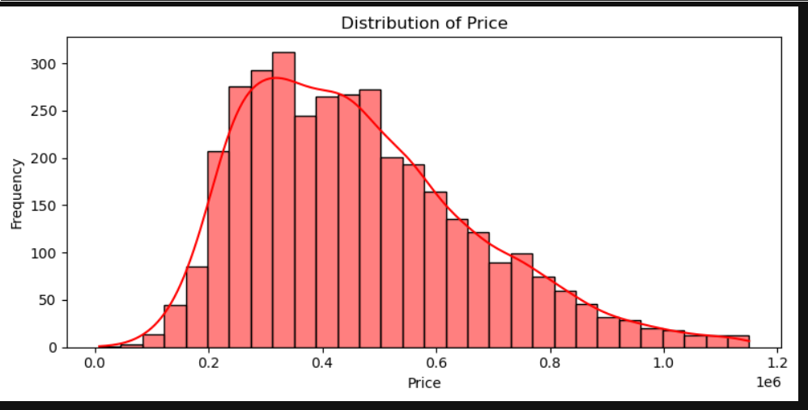
UNIVARAIANT

Slide 9
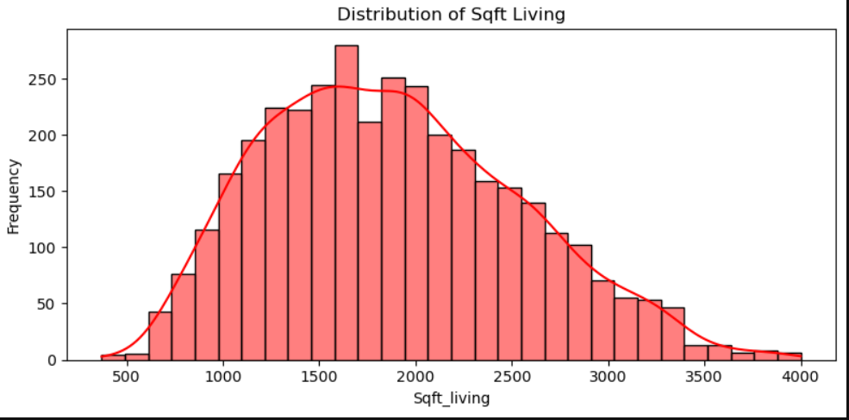
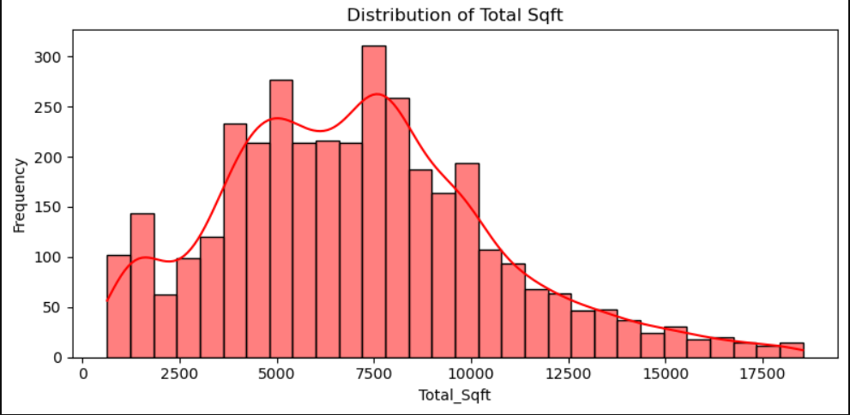

Slide 10
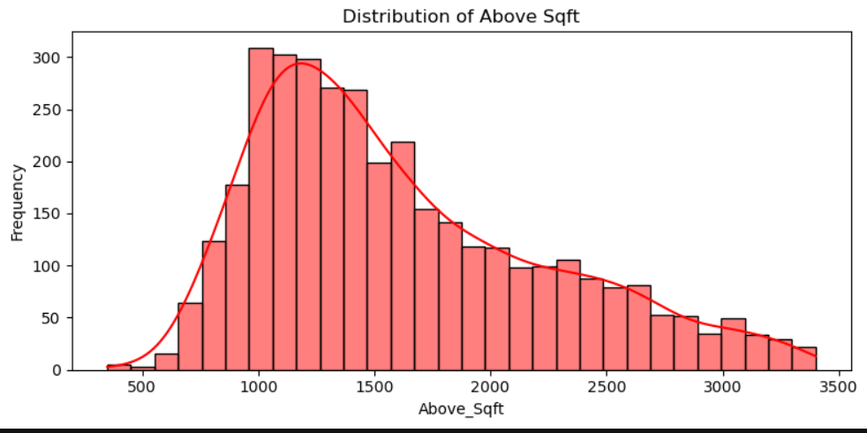
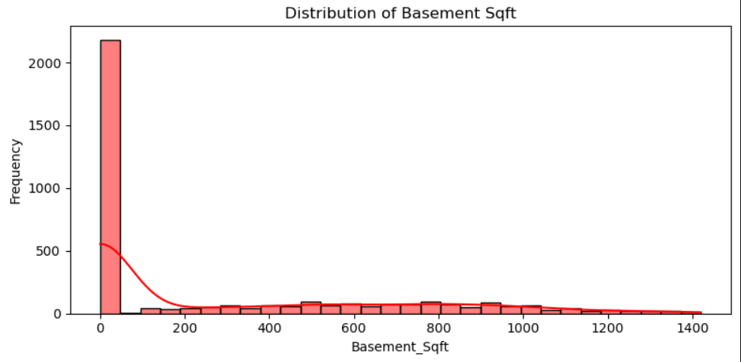

Slide 11
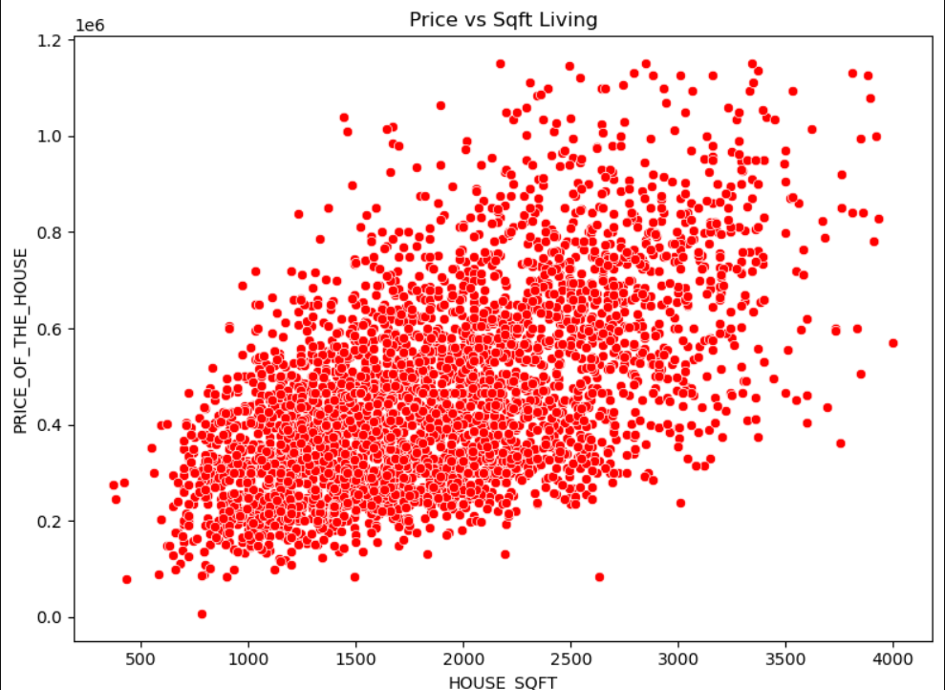
BIVARIANT

Slide 12
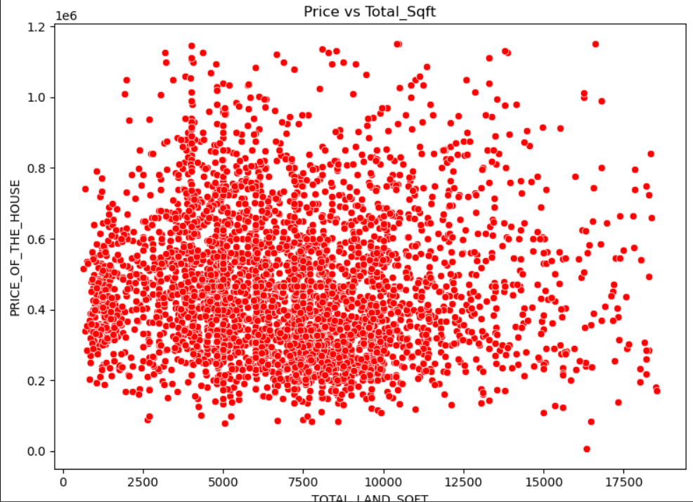
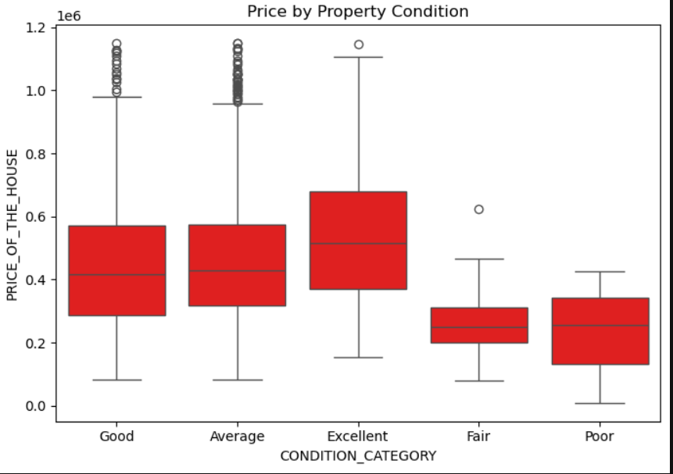

Slide 13
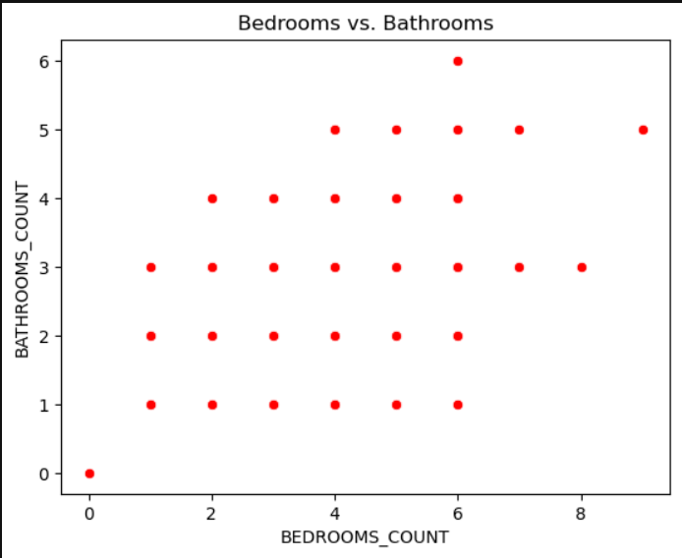
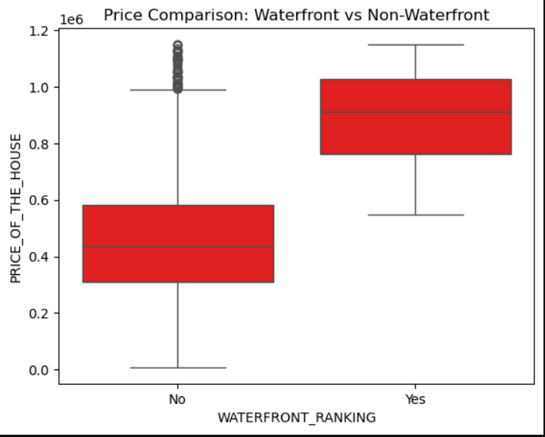

Slide 14
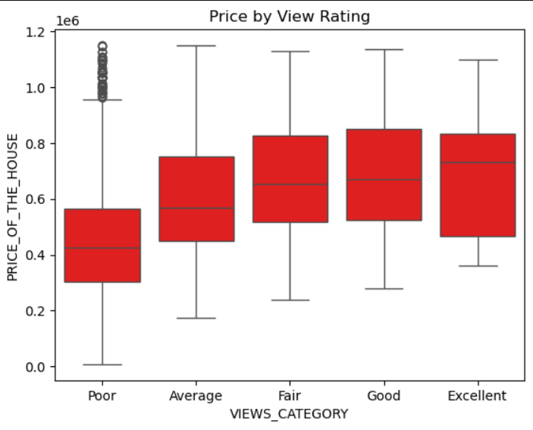
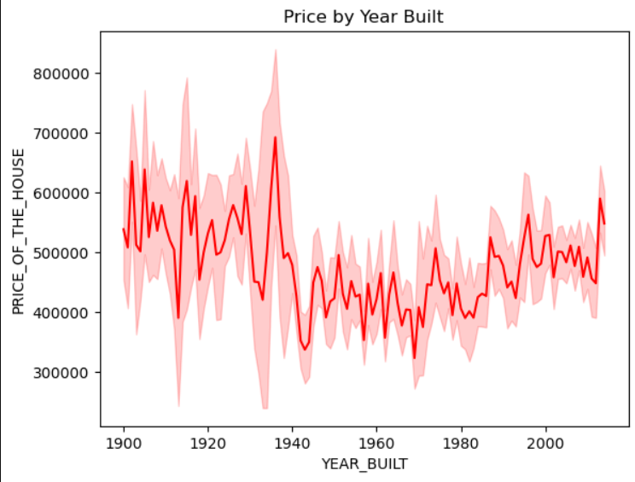

Slide 15
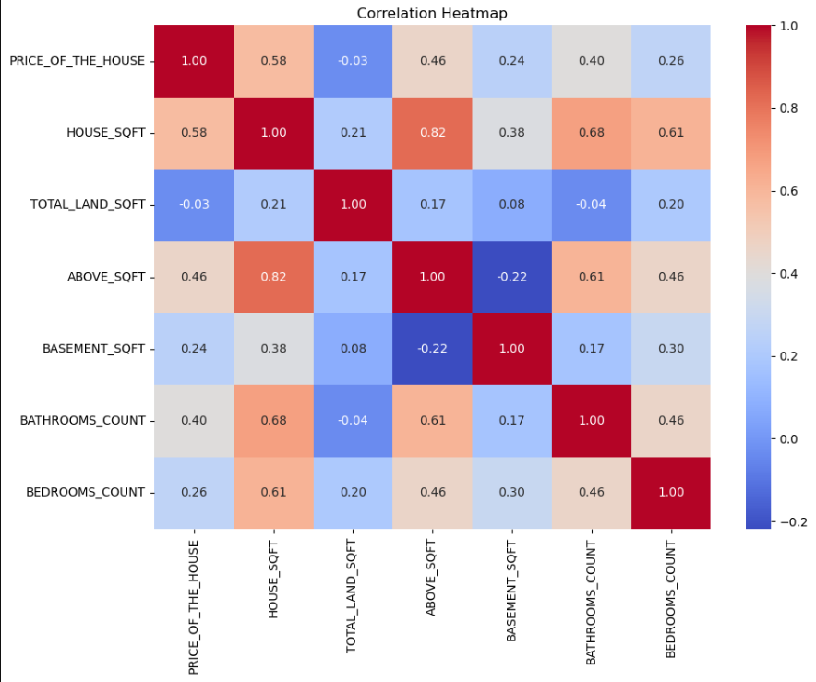
MULTIVARIANT

Slide 16
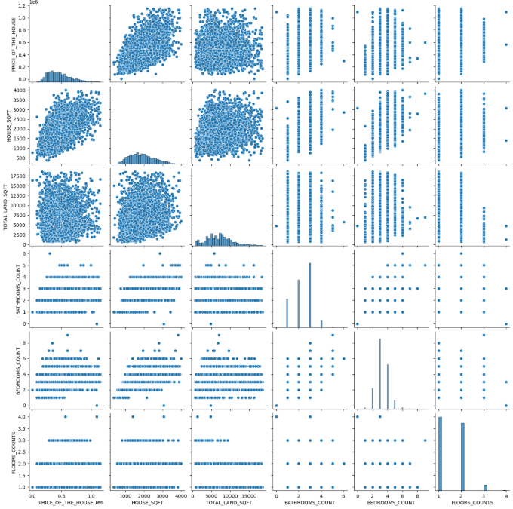

Slide 17
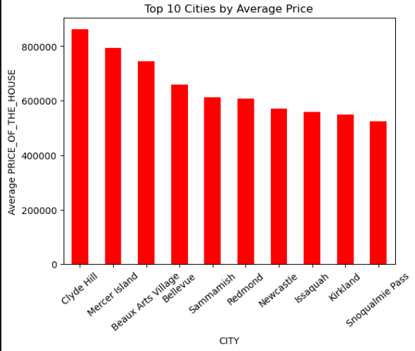

Slide 18
RECOMMENTATION
Focus on Mid-Range Developments: Real estate developers should focus on constructing mid-sized homes (1500–2500 sqft), as these have the highest market demand and transaction volume.
Enhance Property Features: Renovations that improve bathrooms, increase living space, or add above-ground sqft are more likely to result in price appreciation. Adding quality views or enhancing curb appeal also boosts valuation.
Target Premium Locations: Investments in high-value cities such as Clyde Hill or Mercer Island can offer better returns due to consistent high pricing trends. These markets, although smaller, cater to affluent buyers.
Avoid Overemphasis on Land Size: Since lot area doesn't heavily influence price, particularly in urban markets, stakeholders should consider optimizing interior layout rather than acquiring larger plots.
Use Feature Engineering in Modeling: Variables like age of the home, renovation status, and property condition provide rich context. Including these derived metrics will improve the performance of predictive models and guide investment decisions better.

Slide 19
CONCLUSION
Mid-Sized Homes Dominate the Market: The majority of houses in the dataset fall between 1000–2500 sqft, with the highest frequency around 1750–2000 sqft. These homes are aligned with average family requirements and represent the most traded segment.
Price Influenced by Key Features: Living area (sqft_living), number of bathrooms, and presence of a waterfront view are positively correlated with price. Homes with scenic views or modern renovations tend to attract premium pricing.
View and Condition Matter: Properties rated high in view and condition show significantly higher median prices, confirming that aesthetics and maintenance directly affect buyer willingness to pay.
Location Drives Value: Cities like Clyde Hill, Mercer Island, and Beaux Arts Village command the highest average prices, emphasizing the impact of geography, exclusivity, and possibly amenities on property valuation.
Weak Influence of Land Area: Surprisingly, land area (sqft_lot) does not show strong correlation with price, indicating that homebuyers prioritize interior space and features over lot size—especially in urban settings.

Slide 20
THANK YOU!

